Slide 1
CUSTOMER VALUE MODELING (CVM) ENABLING THE SCIENTIFIC ENTERPRISE
Manam Bharadwaj
2021MT13176
2021mt13176@wilp.bits-pilani.ac.in

Slide 2
System and Goal
This project is about my workspace where we have developed a Scientific Modeling System in the field of biodiversity and material science.
The system works as robotic framework which leverage diverse data and then models it to reveal insights and flags related to future risks.
Goal of the system is to have an highly efficient presentation system sitting on large unutilized data, processing it with easy interface to users and then presenting a single simplified view at real time.

Slide 3
Key Requirements
Functional Requirements:
- Users should be able to login in to system.
- Users should be able to access application layout for workspace
- Users should be able to connect components in workspace.
- Users should call component connectors and must be able to take data inputs.
- Users should be able to run protocols
Non Functional Requirements:
- Very high performant system for live data streaming( concurrent 500 streams at a time )
- Very high available system for modeled data calligraphy( concurrent 500 streams at a time)
- High security to prevent loss of proprietary content and application layer protection
- Highly available system as migration happens daily throughout year.

Slide 4
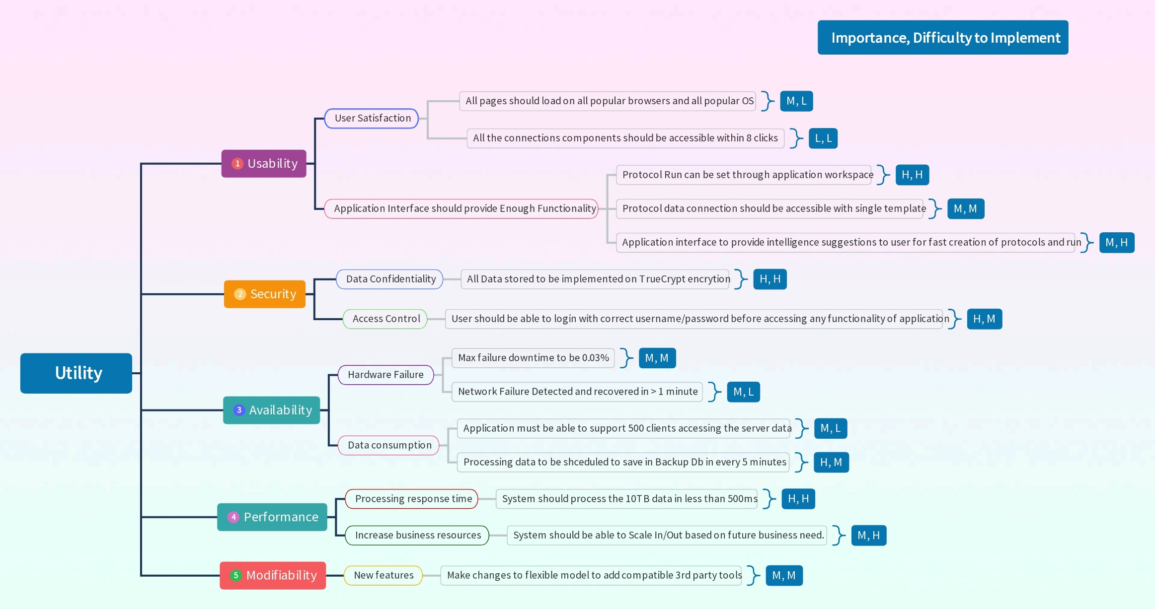
Utility Tree Diagram

Slide 5
Use Cases
Use Case | Description
UC-1: Monitor Online Services | On-duty operations staff can monitor the current state of services and IT infrastructure (such as web server load, user activities, and errors) through a real-time operational dashboard, which enables them to quickly react to issues.
UC-2: Troubleshoot online service issues | Operations, support engineers, and developers can do troubleshooting and root-cause analysis on the latest collected logs by searching log patterns and filtering log messages.
UC-3: Provide management reports | Corporate users, such as IT and product managers, can see historical information through predefined (static) reports in a corporate BI (business intelligence) tool, such as those showing system load over time, product usage, service level agreement (SLA) violations, and quality of releases.
UC-4: Support data analytics | Data scientists and analysts can do ad hoc data analysis through SQL-like queries to find specific data patterns and correlations to improve infrastructure capacity planning and customer satisfaction
UC-5: Anomaly detection | The operations team should be notified 24/7 about any unusual behavior of the system. To support this notification plan, the system shall implement real-time anomaly detection and alerting (future requirement).
UC-6: Provide security reports | Security analysts should be provided with the ability to investigate potential security and compliance issues by exploring audit log entries that include destination and source addresses, a time stamp, and user login information (future requirement).

Slide 6
Tactics used to achieve ASRs
Availability
Server fault detection system at place using heartbeat mechanism
Redundancy maintained through AWS Cloud horizontal scaling system used for 99% available system
Rollback and System Monitor at place for fault recovery and fault detection
Security:
Service Denial and Message detection at place
Attack resistance is at place through data encryption and actor authorization with data access limit. This includes HMAC encryption technique
System reboot and lock and availability check after restore is at place
Ongoing and automated inspection and monitoring of web applets and enable Kerberos network security protocols

Slide 7
Tactics used to achieve ASRs
Usability:
Made the system browser agnostic
Separate user interface using Clean Architecture
Made the system OS agnostic
Metadata implementation for reusable template suggestions
Performance:
Resource demand and management handled with DDM at place for caching and faster retrieval to achieve maximum performance
Extensive multithreading and background tasks are used for client application performance.
Performance dashboard indicating multiple metrics set for real time monitor of performance
At a time 500 client applications can happen parallel with server using data processing technologies like kafka spark and Hadoop

Slide 8
Tactics used to achieve ASRs
Modifiability:
Micro services and Micro Frontend Architectures to make system highly modifiable.
Used Clean Architecture Patterns like onion architecture to create web app and desktop applications which can be modified easily
Hyper separation of concern, SOLID principles and composition over inheritance used to achieve easily modifiable modules.

Slide 9
Quality Attribute Scenarios
ID | Quality Attribute | Scenario | Associated Usecase
QA-1 | Performance | The system shall collect up to 15,000 events/ second from approximately 300 web servers. | UC-1,2,5
QA-2 | Performance | The system shall automatically refresh the real-time monitoring dashboard for on-duty operations staff with < 1 min latency. | UC-1
QA-3 | Performance | The system shall provide real-time search queries for emergency troubleshooting with < 10 seconds query execution time, for the last 2 weeks of data. | UC-2
QA-4 | Performance | The system shall provide near-real-time static reports with per-minute aggregation for business users with < 15 min latency, < 5 seconds report load. | UC-3, 6
QA-5 | Performance | he system shall provide ad hoc (i.e., non predefined) SQL-like human-time queries for raw and aggregated historical data, with < 2 minutes query execution time. Results should be available for query in < 1 hour. | UC-4
QA-6 | Scalability | he system shall store raw data for the last 2 weeks available for emergency troubleshoot ing (via full-text search through logs). | UC-2
QA-7 | Scalability | The system shall store raw data for the last 60 days (approximately 1 TB of raw data per day, approximately 60 TB in total). | UC-4
QA-8 | Scalability | The system shall store per-minute aggregated data for 1 year (approximately 40 TB) and per-hour aggregated data for 10 years (approximately 50 TB) | UC-3, 4 6
QA-9 | Extensibility | The system shall support adding new data sources by just updating a configuration, with no interruption of ongoing data collection. | UC-1, 2, 5
QA-10 | Availability | The system shall continue operating with no downtime if any single node or component fails. | All use cases
QA-11 | Deployability | The system deployment procedure shall be fully automated and support a number of envi ronments: development, test, and production. | All use cases

Slide 10
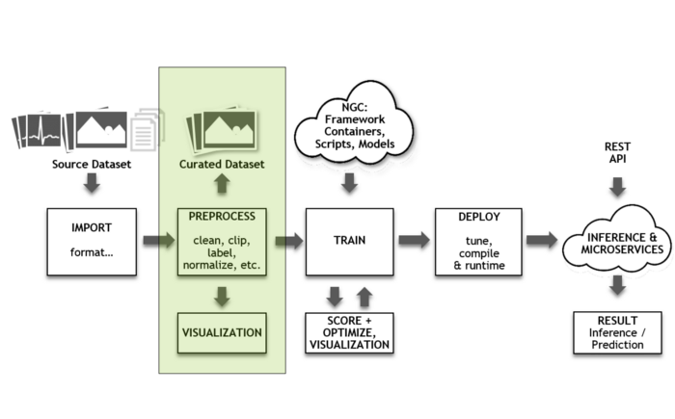
Context Diagram

Slide 11
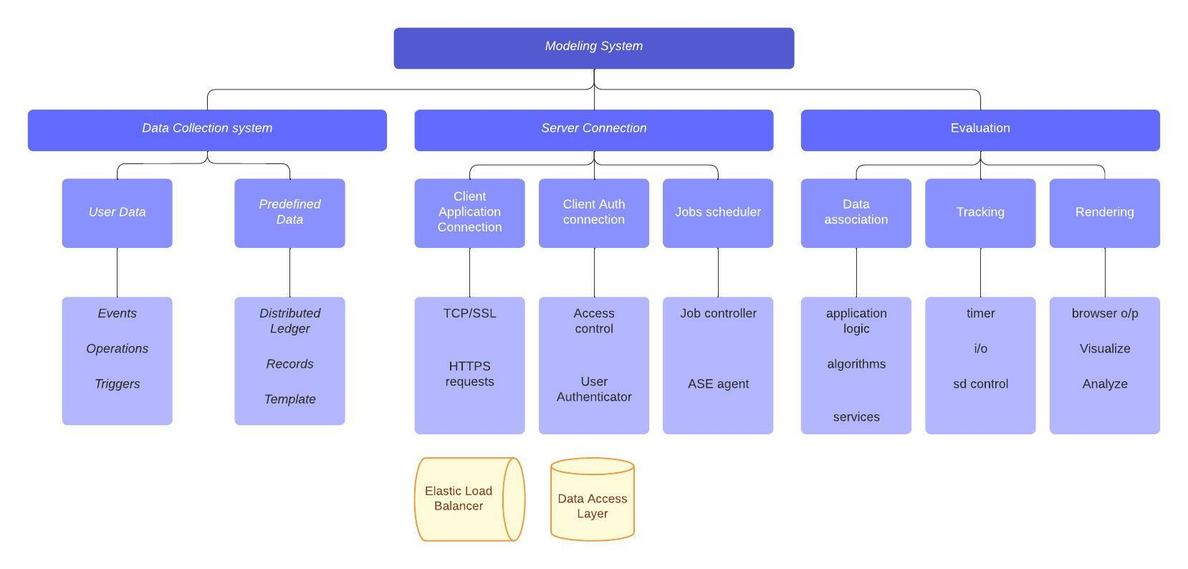
Module Decomposition

Slide 12
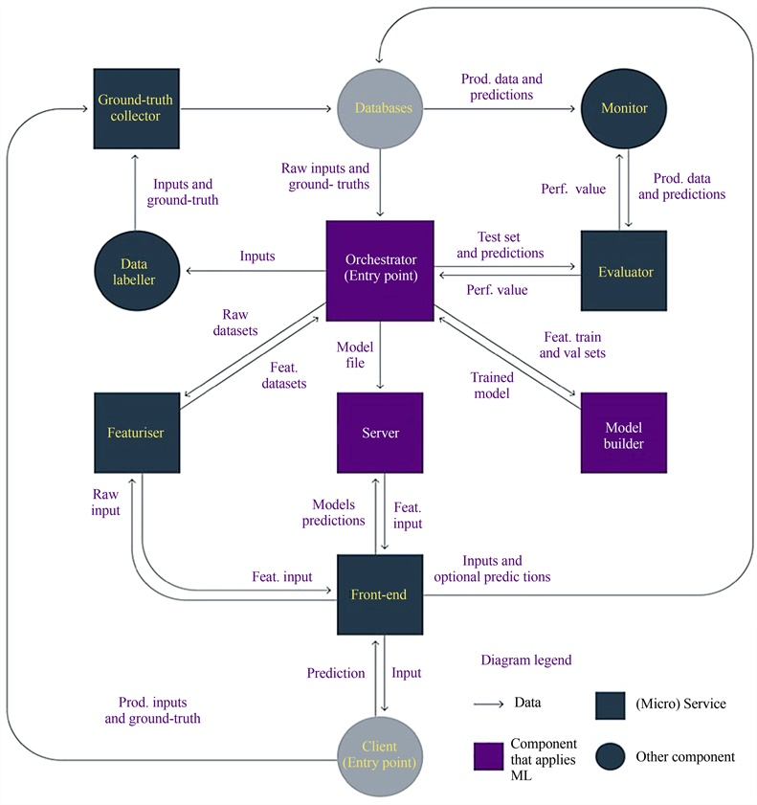
Component and Connection Diagram

Slide 13
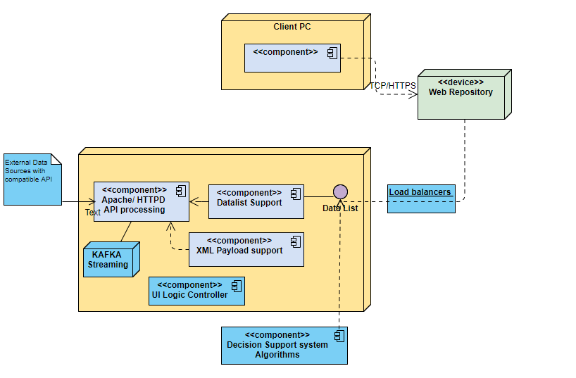
Deployment Diagram

Slide 14
How System Works
System is working as Client Server Architecture
There are two type of Clients which communicate with a central server
All sort of Client and Server communication happens through central server through TCP/IP.
Data Visualization Stream happened with a socket implemented on server
Technologies like spark and Kafka at place to handle streams
Both clients have implementation of Algorithm applets and Logic controller which can be shared through a central server.
Communication between Client and Server happens with REST services and Socket connection
Server follows the Micro services Architecture to provide REST APIs and Socket Connections
Connect to external data sources via an extensive library of APIs
Creates and combines interactive charts and visuals for key stakeholders Fully HTML 5 compliant.
Graphs include: Scatter plot, Line Plots, Pie Charts, Bar Plots, Histograms, Polar Plots and Interactive tables with sorting, search.

Slide 15
Key Learnings
Learnt to handle following challenges in architectural planning and design phase.
What is the time available for the architectural analysis/evaluation? It is challenging enough to come up with one solution, let alone a few!
What is the product pipeline for the next 1–3 years? And what other projects are lined up? Can we see any synergies?
What is system current technical debt that we could potentially address?
And turning this around: How much new technical debt will incur if you pursue a tactical solution?
Which quality attributes tend to be the most important for systems in my organization and how will they be compromised by the proposed solution?
Apart from the architecture team who else is a stakeholder that will affect the decision? The Business? My Manager? The Technical Design Authority? What are the key objectives of each stakeholder? How will I mitigate conflicting needs!
Learnt to handle following technical, high level and low level design aspects of architecture planning
Such system require must plan for ASRs and NFRs at architectural planning level.
The SOLID principles just do not only apply on software development but also when architecting a system
Client system is live for an hour at a time so error handlings (Network, Hardware issues) must be at its best and well designed
User Interface is as important as functionality of the system as different type of users using a complex UI
System availability and performance is most important concern and must be handled properly as system needs to be available throughout the year
As system is quite big module decomposition ( Micro services and Micro frontends ) should be planned seriously
Component connections can not be easily modifiable so must be planned before hand in architecture
Durability is an example of an architectural concern, in the sense that it does not appear in any requirements document, but the architect has to deal with it nonetheless

Slide 16
THANK YOU

